Slide 1

Serverless Framework
Alon Sabi March 23rd , 2022

Slide 2
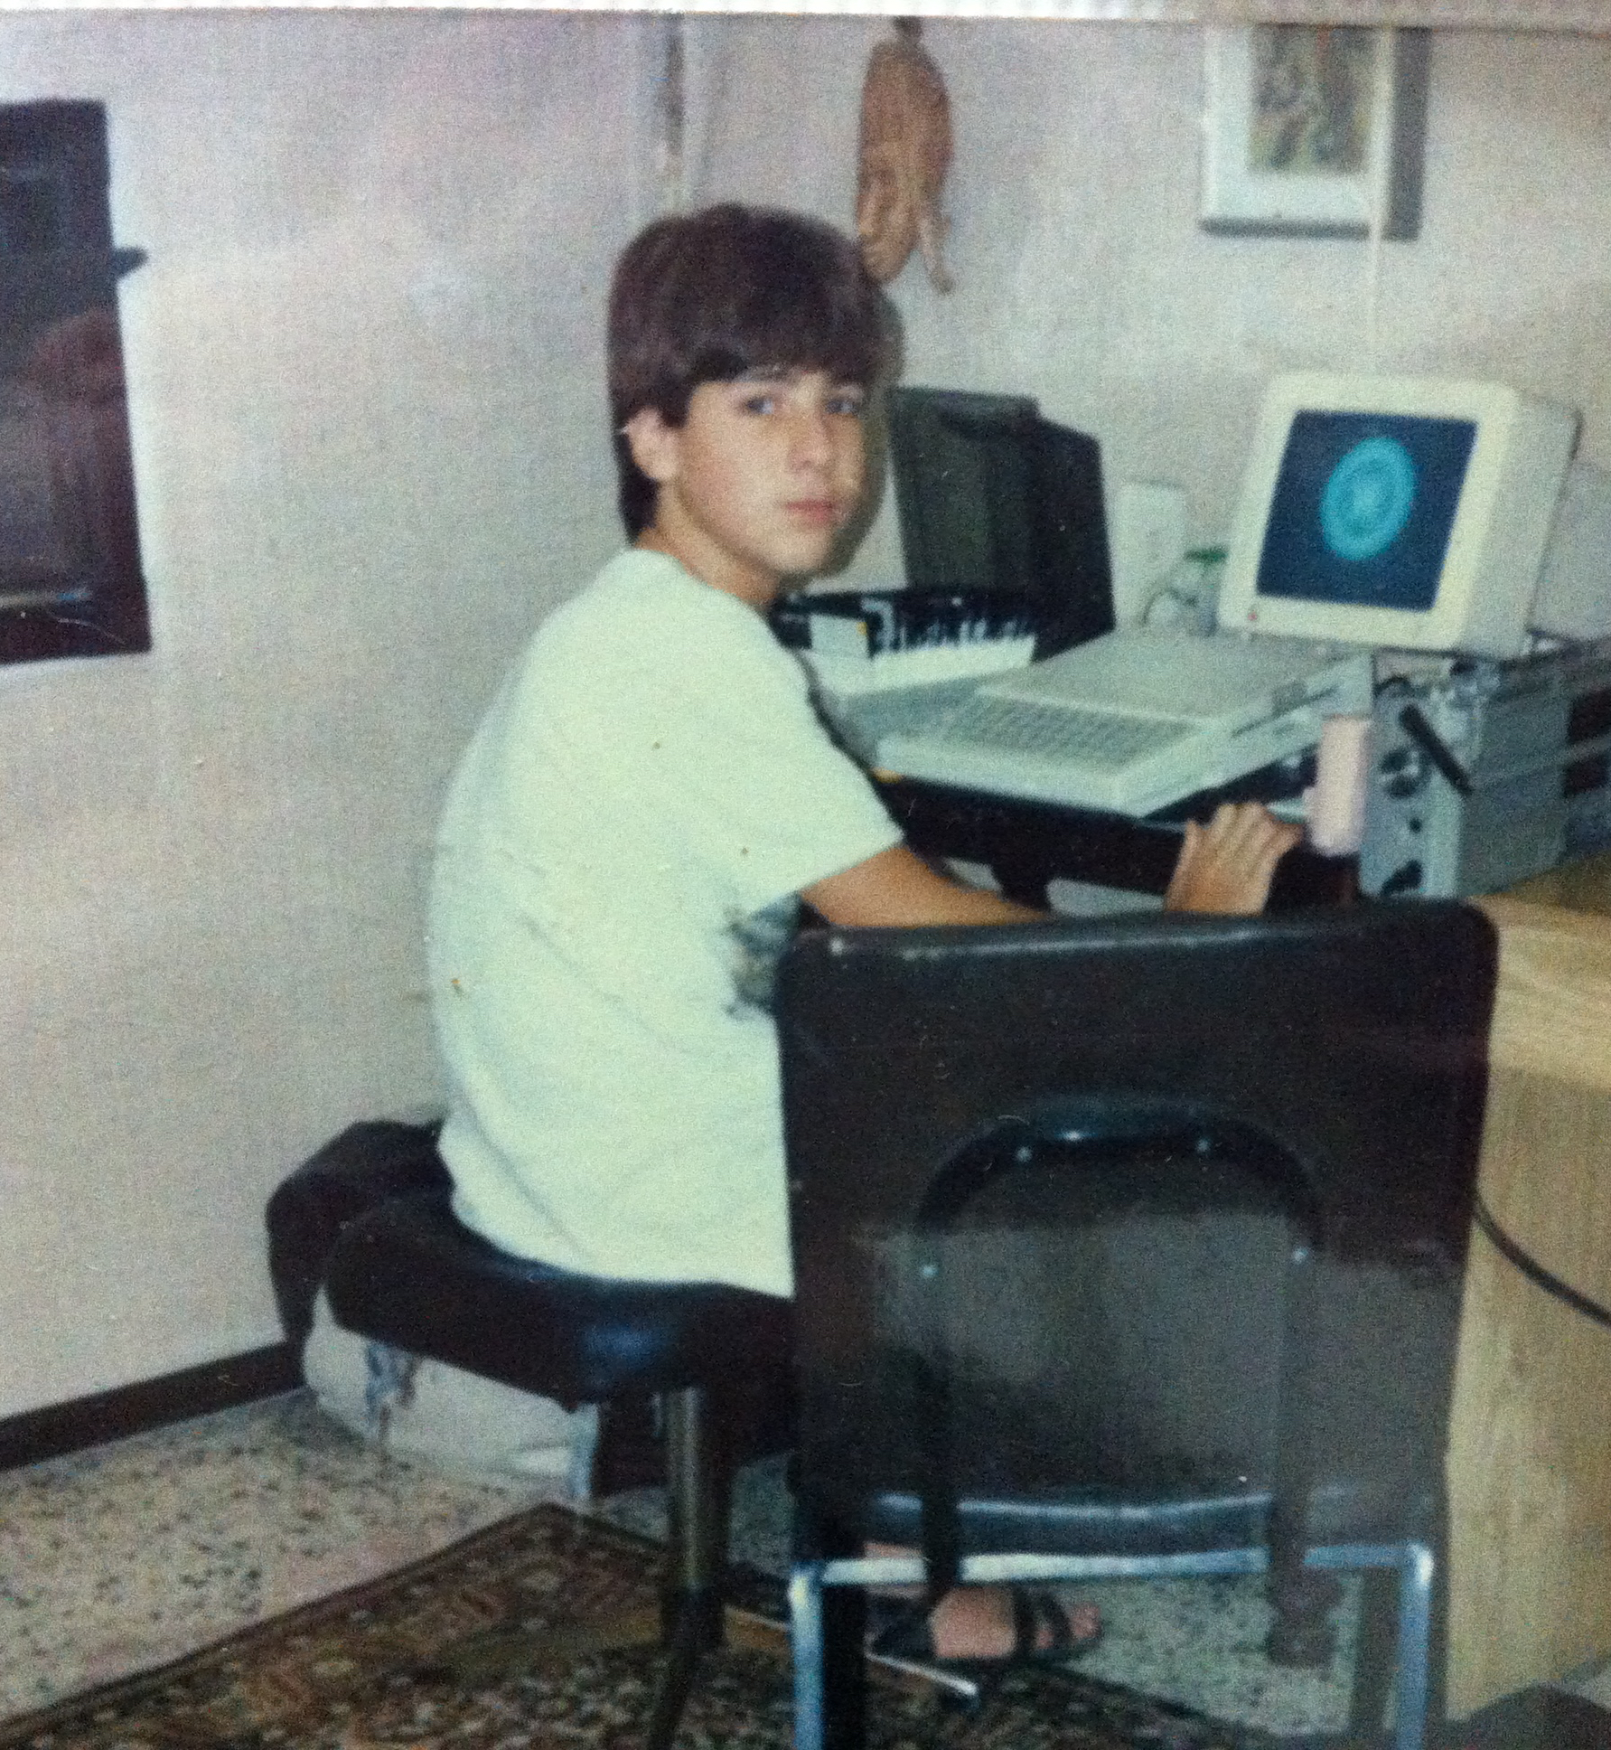
About Me
Web developer for about 10 years.
R&D Management for about 15 years.
In the past year back to development:
https://addyinvest.com
https://sabi.ai

Slide 3

Serverless Framework
Infrastructure as code
Code deployment
Can run Lambda locally and invoke remotely
A wrapper around CloudFormation
Over 1,000 plugins (https://www.serverless.com/plugins)
Geared towards Lambda and http API gateway
Extendable using CloudFormation scripts
Free (for very small teams)

Slide 4

Serverless Framework Dashboard

Slide 5
Useful Plugins
Serverless Prune Plugin
Serverless Domain Manager
Serverless Python Requirements
Serverless Ruby Package
Serverless S3 Deploy
Serverless VPC discovery

Slide 6

Live Demo
Basic Hello World
Adding secrets
Adding HTTP API Gateway
Extending with Cloudformation + Permissions
Deploy to different stages with the same code

Slide 7

Questions?

